Slide 1
MGPG – Group 7
George Heath-Collins, Brad Pablo, Katie Millar and George Croucher

Slide 2

Goals of the Brief
Game must be 2D
Controlled by tapping
Turn-based multiplayer
Competitive
Single Device (mobile)
Symmetric and simple to play
Casual

Slide 3
Chop ‘til you drop

Slide 4
So what does the player do?
Tree is assigned a random health value.
Player One taps to chop the tree.
Power of hit depends on how full the Power Bar is.
Player Two taps to chop the tree.
The player who cuts down the tree loses.
Each player must cut, or else they will forfeit.

Slide 5
Game Flow and Type of Fun
Next Player Start
Player Cuts Tree
If Tree Doesn’t Fall?
End Player Turn
Type of fun: Hard Fun and People Fun.
Competing with adversaries.
Re-playable through gameplay variables.
Interaction between players.

Slide 6
How has the game been iterated?
Avoid rapid tapping to make the game more casual.
A focus on visual feedback.
Haptic Feedback tailored to suit the mobile platform.
One player uses the phone at a time.
Increasing difficulty.

Slide 7
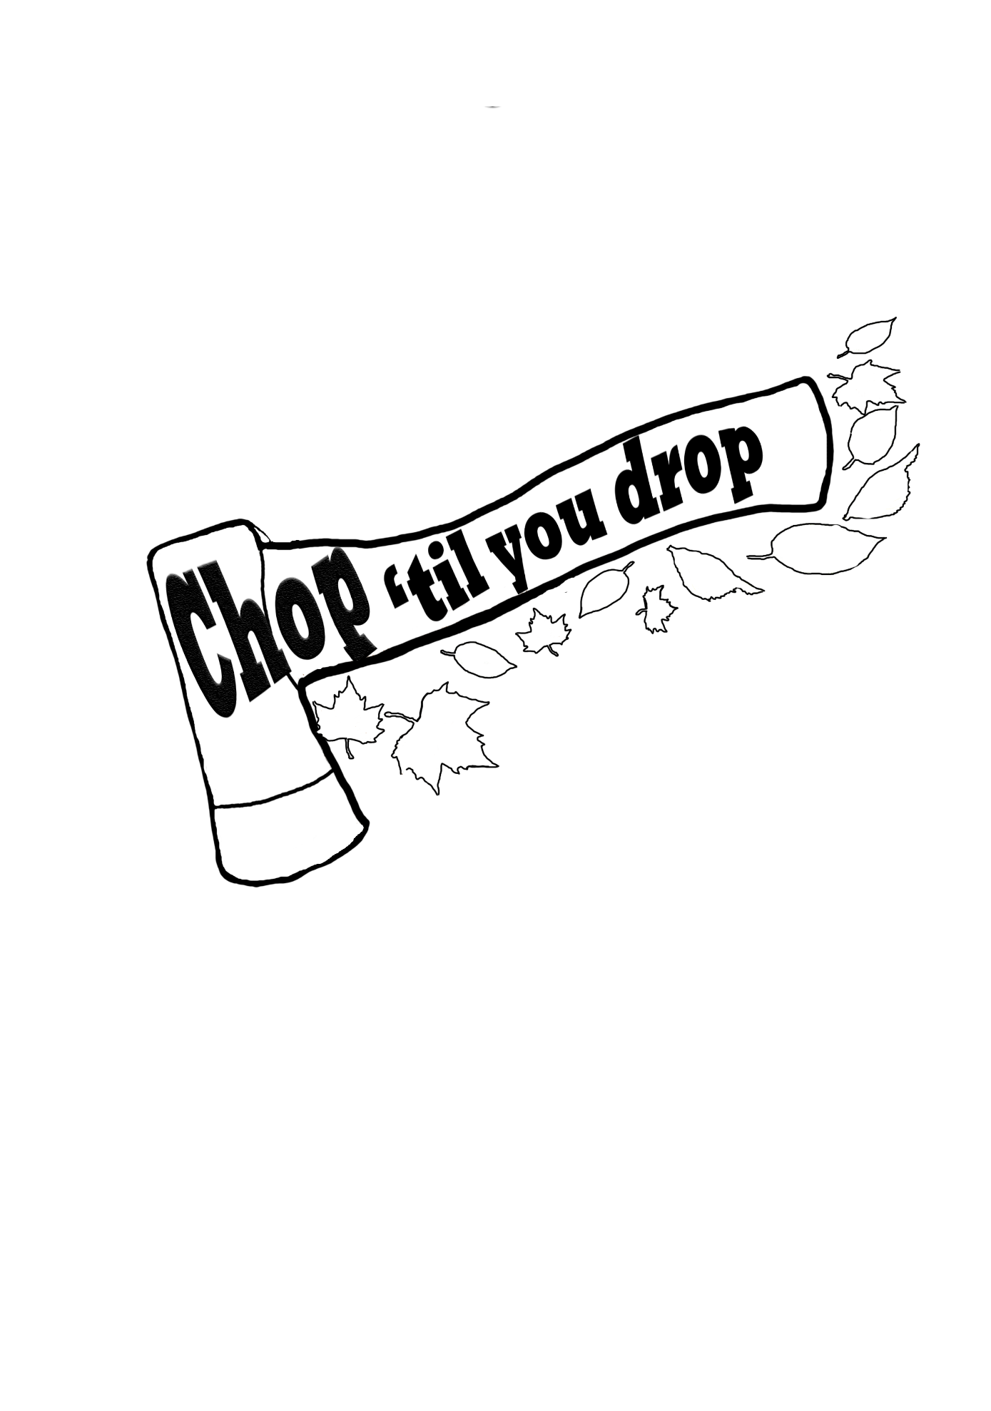
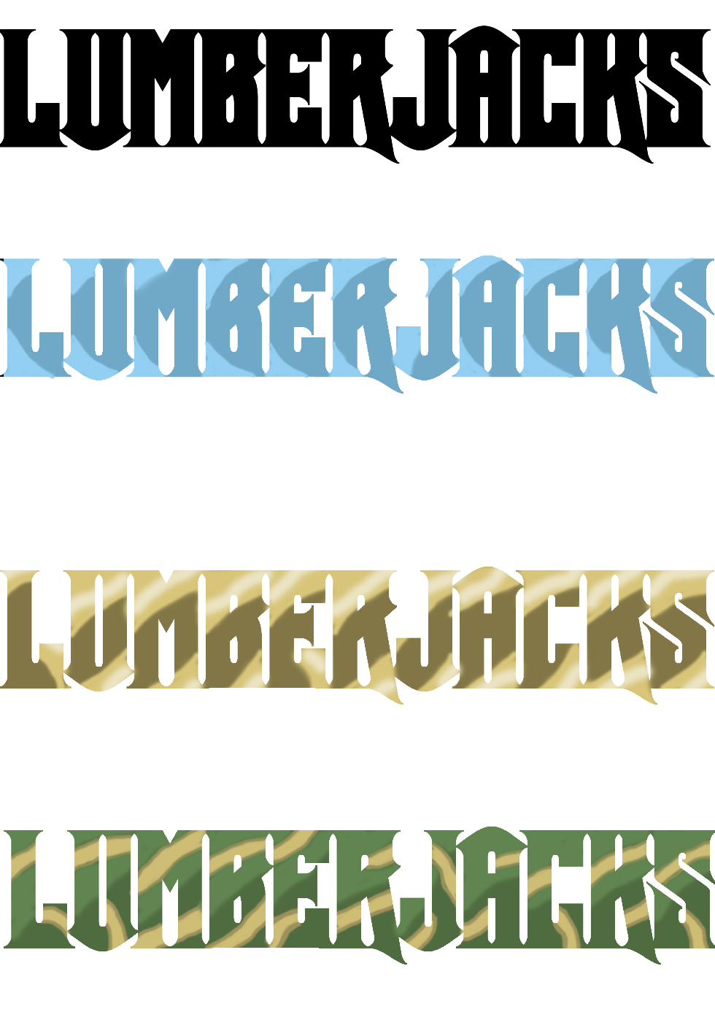

Title Concepts

Slide 8
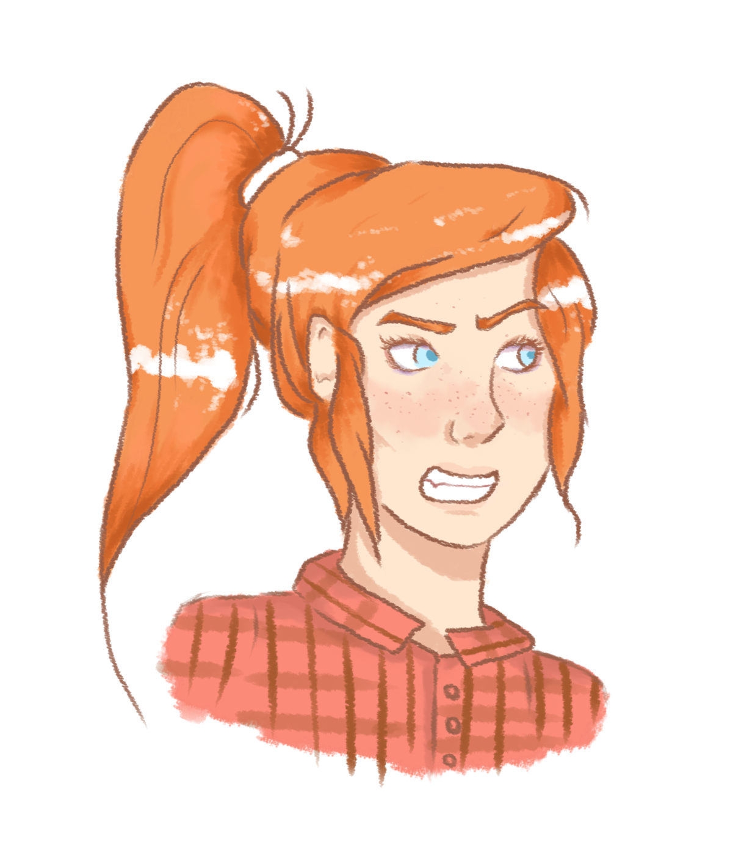
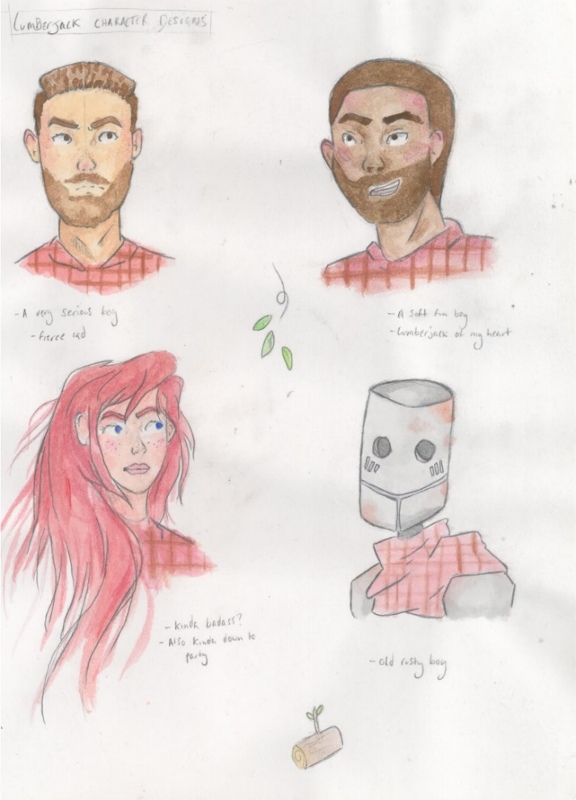
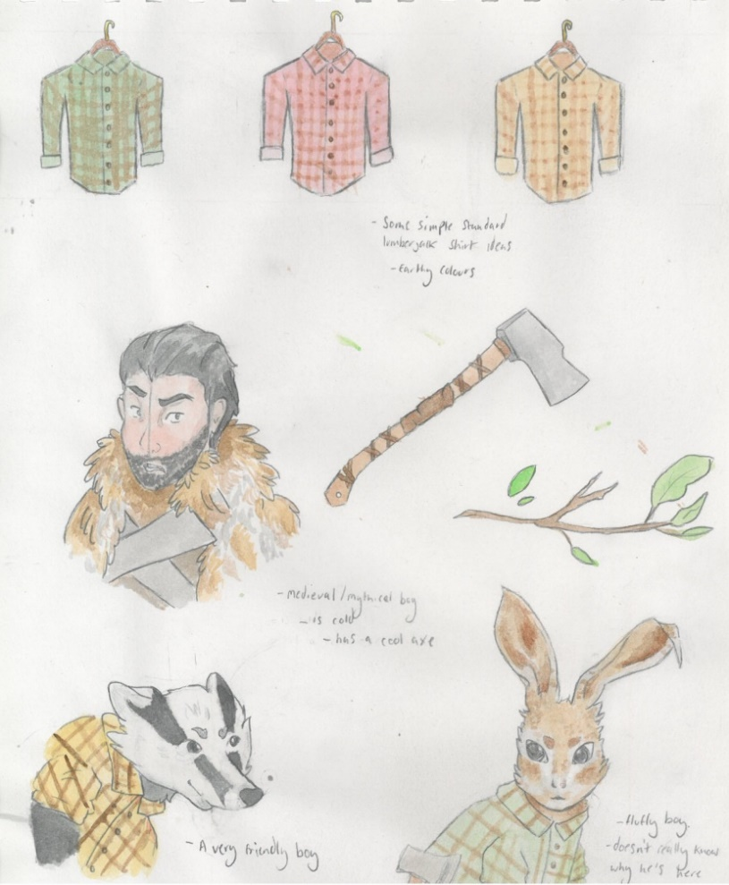
Character Concepts

Slide 9
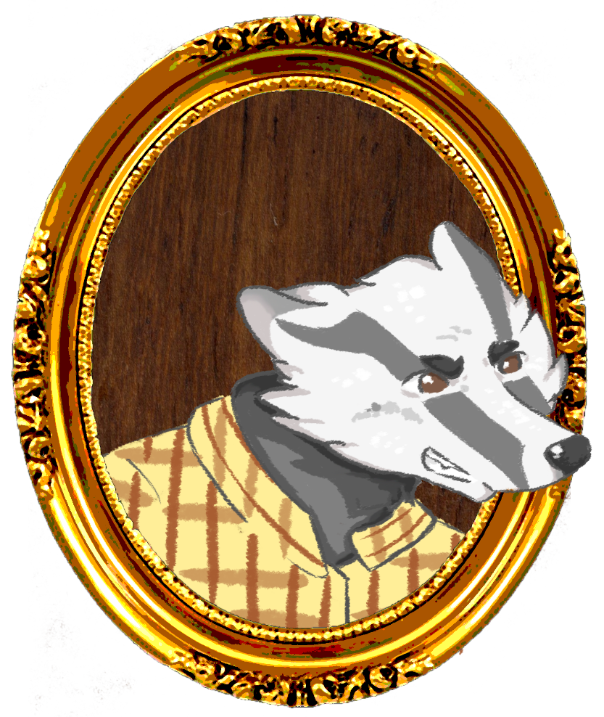
What will the game Feature?
An increasing difficulty system.
Up to 4 players.
Immersive haptic feedback to build tension.
Visual Feedback through particle systems and camera movement.

Slide 10
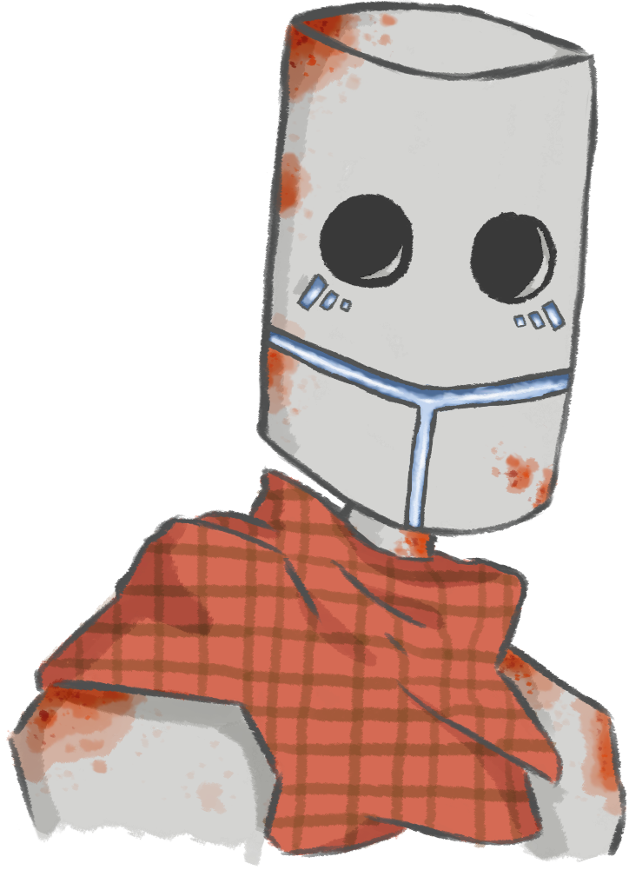
How does the game meet the brief?
The game is displayed in 2D, with each player having a different side.
It is a competitive, turn-based game.
It uses a single device for local multiplayer.
Symmetric in both layout and gameplay.
Controlled using a single tap making it accessible to the Casual Gamer.

Slide 11
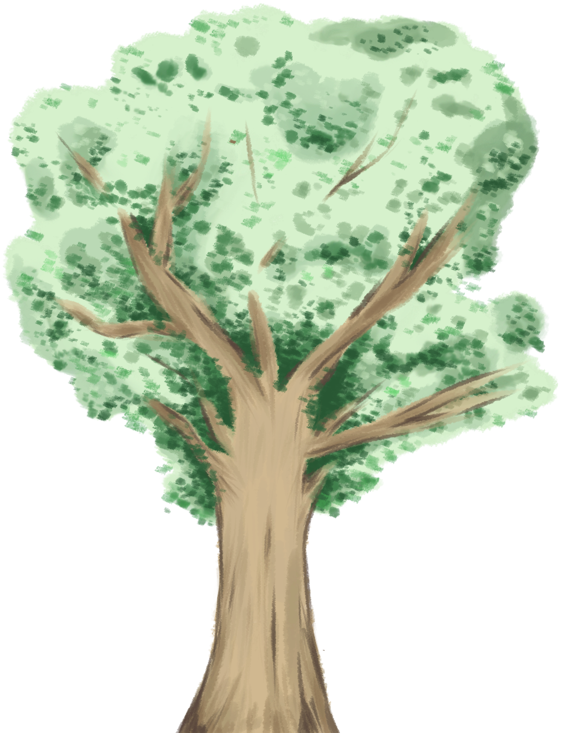
Any Questions?
Thanks for listening!

